Slide 1
Scikits Iowa Alcohol Distributors - Machine Learning Project
AMIL WALGAMAGE, JAMIE TAN & TAS TUDOR

Slide 2
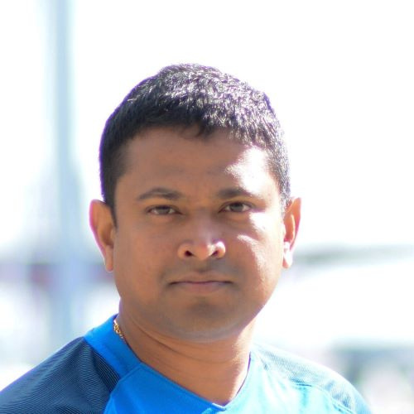
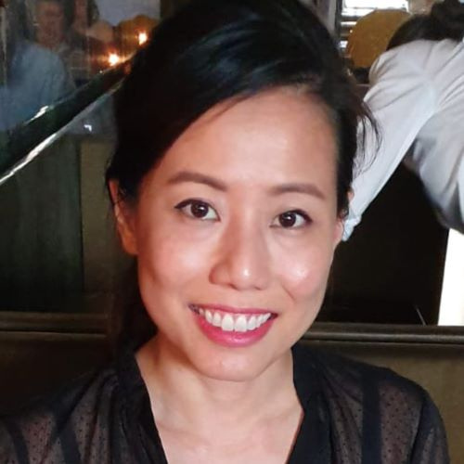
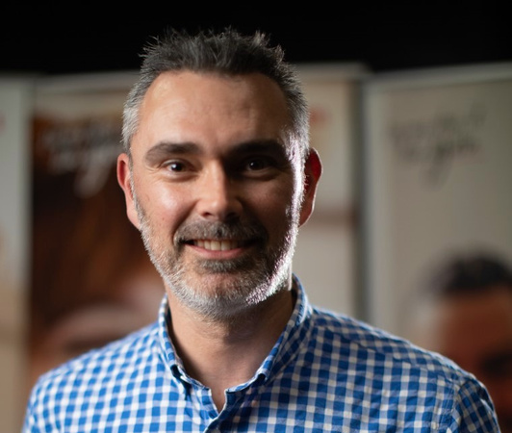
THE TEAM
Amil Walgamage
Jamie Tan
Tas Tudor

Slide 3

PROJECT SUMMARY
High Level:
Machine learning product recommender for wholesale liquor outlets in Iowa USA to increase conversion rates & revenue per customer.
Successfully Completed:
Built and deployed working machine learning web app with a personalised product recommender based on data obtained from Google's public datasets.
According to McKinsey:
35%
of consumer purchases on Amazon come from product recommendations^.
^ https://www.mckinsey.com/industries/retail/our-insights/how-retailers-can-keep-up-with-consumers

Slide 4
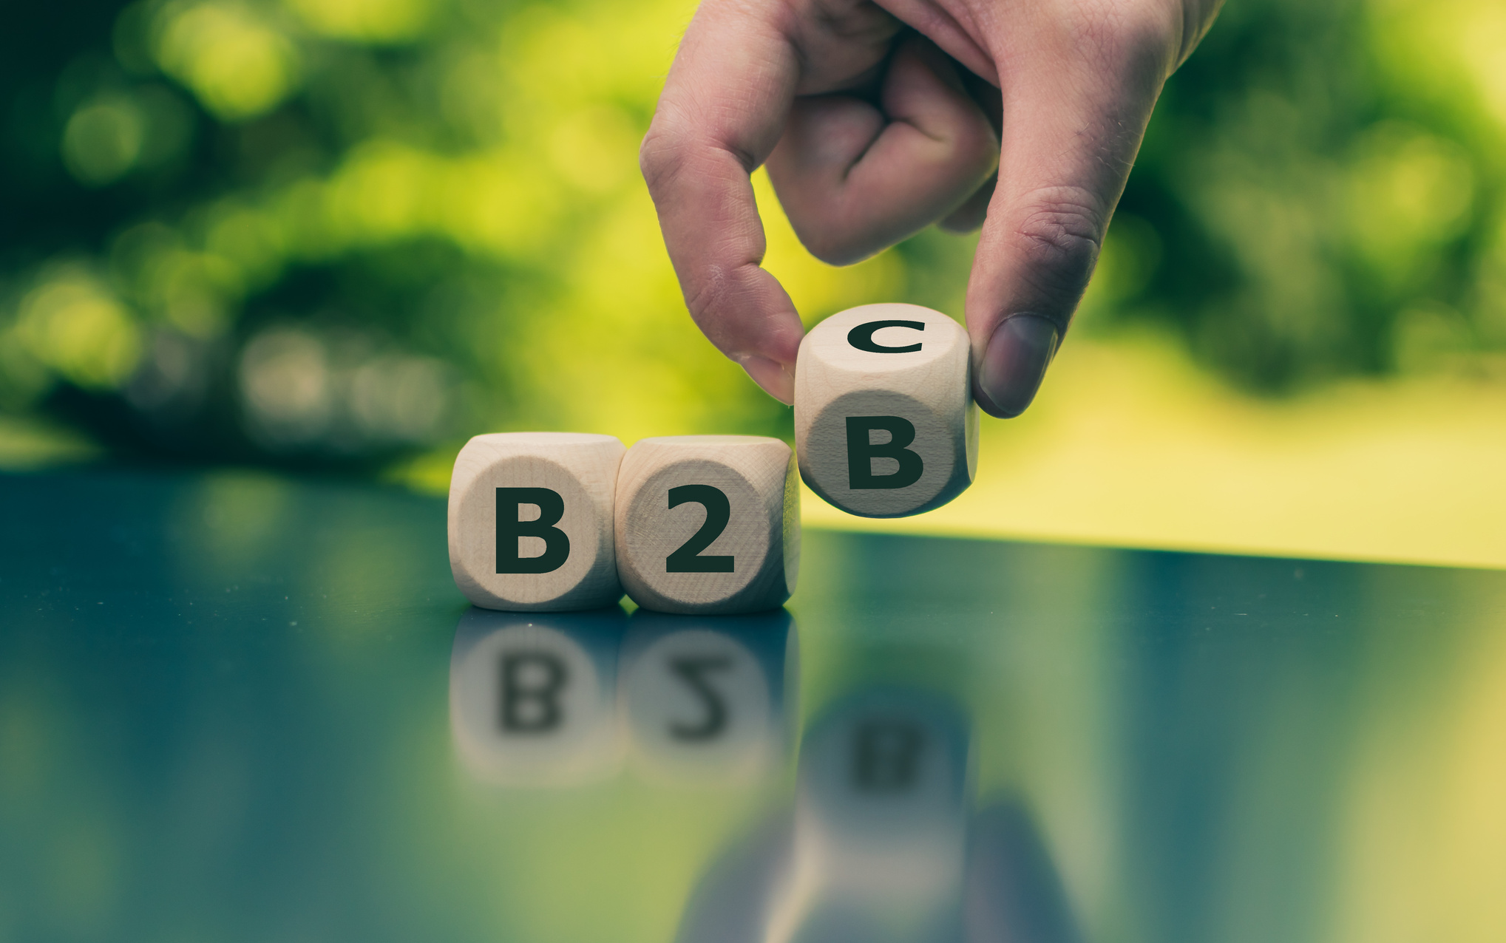
PRODUCT DEMO

Slide 5
PROJECT WORKSTREAM
20 Oct
21 Oct
22 Oct
23 Oct
24 Oct
25 Oct
26 Oct
27 Oct
28 Oct
29 Oct
30 Oct
31 Oct
Concept Development
Concept Build
Pivot to B2B
Data Discovery
Identify Data Source
EDA
Preliminary EDA
Continuing & Final EDA
Data Extraction
Data Extraction
Webscraping
Scrape Images
Test & Embed
Machine Learning
ML Library Selection
Machine Learning
Test & Embed
Build Flask App
Flask Application
Test & Embed
Website Requirements
Define Website Requirements incl UX
Review and Testing
Test & Embed
Web App Development
Web App Development
Test & Embed
Deployment
Deploy to Heroku
Test & Embed
Documentation & Presentation
Documentation, Readme & Presentation
Present

Slide 6





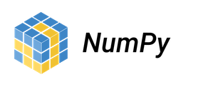
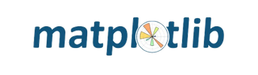






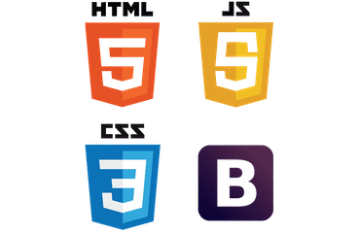


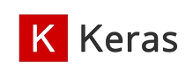



THE TOOLBOX
TOOLS & MACHINE LEARNING
VISUALISATIONS
SOURCES
WEB APP
CHARTING TOOLS
DESIGN & FRONT END

Slide 7






THE ARCHITECTURE
Order
ML Model Generator
Python
Flask
App
Suggestion
Data Source
Reference Data Loading & Webscraping

Slide 8



MACHINE LEARNING
9 Learning Models (80/20 Split)
3 Different Techniques
Popularity
Collaborative Filtering (Cosine
Similarity)
Collaborative Filtering (Pearson
Similarity)
Normalised
1st Model
2nd Model
3rd Model
3 Datasets
4th Model
5th Model
6th Model
Dummy
Purch Volume
7th Model
8th Model
9th Model

Slide 9




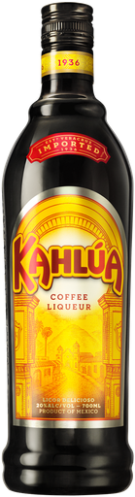
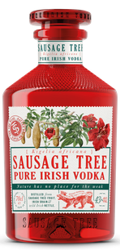
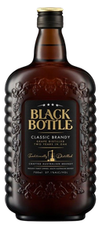
COLLABORATIVE FILTERING
I am Fred
I am Jane
SIMILAR BUYERS
BUY
BUY
BUY
RECOMMEND
BUY
BUY
Based on Fred's extra purchase, Jane is recommended a 3rd product as they purchase similar items

Slide 10
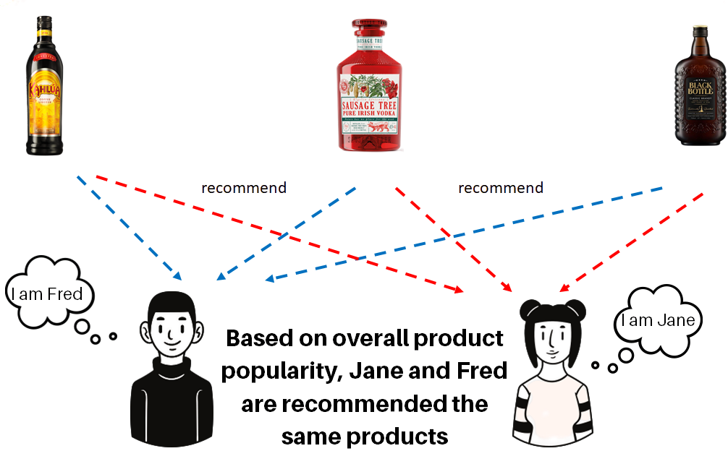
POPULARITY
No. 1
Top Sales
No. 2
Top Sales
No. 3
Top Sales

Slide 11
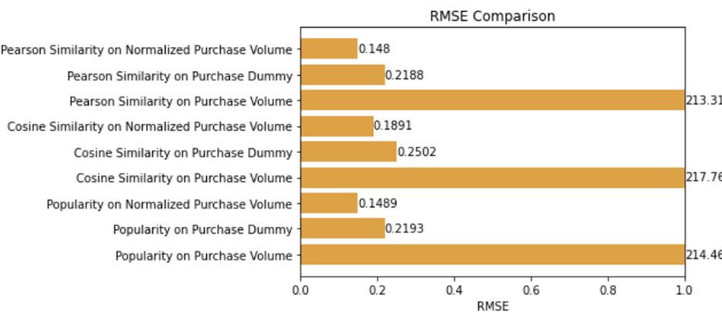
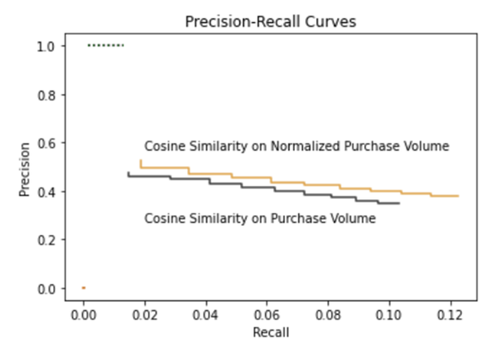
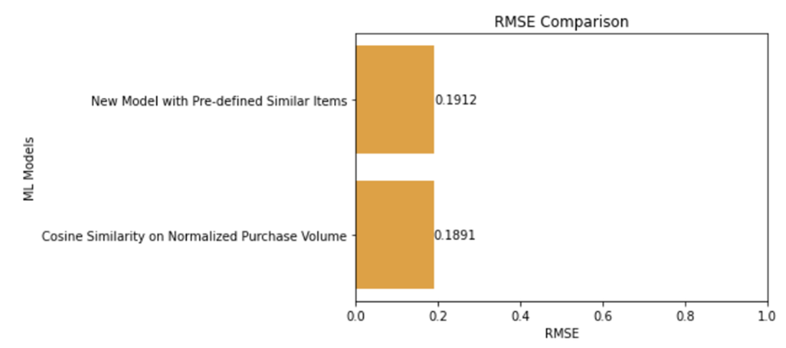
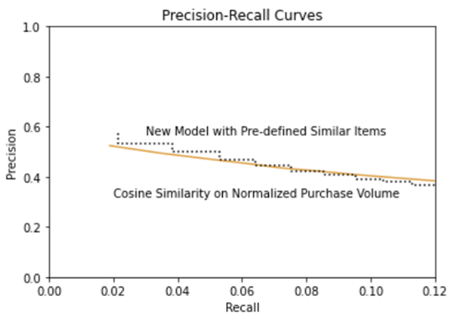
MODEL EVALUATIONS
INITIAL MODELLING
AFTER FINE TUNING THE MODEL

Slide 12

A POWERFUL TOOL
Model Evolution Occurs with New Observations
Exception Handling - Exclude Discontinued Items
Diversity & Randomisation

Slide 13
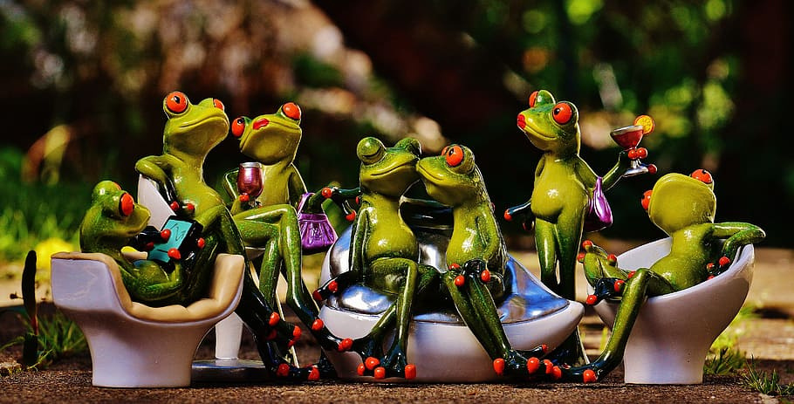
Thank You

Slide 14

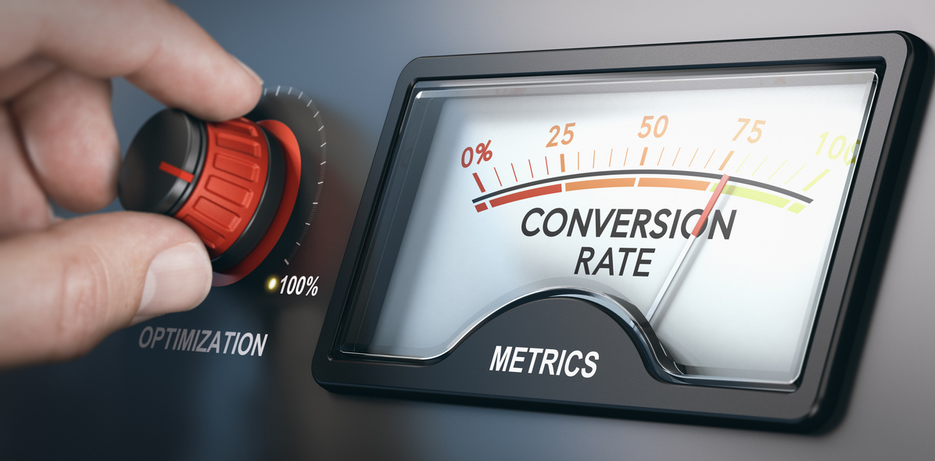

NICE TO HAVE'S & FURTHER DEVELOPMENT TO INCREASE CUSTOMER SPEND
Shopping Cart & Add Multiple Items
Apply continual learning to the Model
Evaluate the conversion rate / ROI
The model accepts multiple items to improve accuracy, but it isn't represent front end yet
New data to optimise the model to ensure relevance
Evaluate the model when it receives new data

Slide 15

QUESTIONS FOR YOU!
If you take on a project such as this, what tools and libraries may you have used?
With your projects, what do you spend the majority of your time doing?
The world of data analytics & science is wide and varied, what are some of the more exciting projects you have worked on?

